Slide 1
Intro to Human Biology 12 – science inquiry review

Slide 2
Types of investigations
Observations
Controlled experiments
Surveys
Trial and Error
Case studies
Longitudinal study
(cross sectional study)

Slide 3
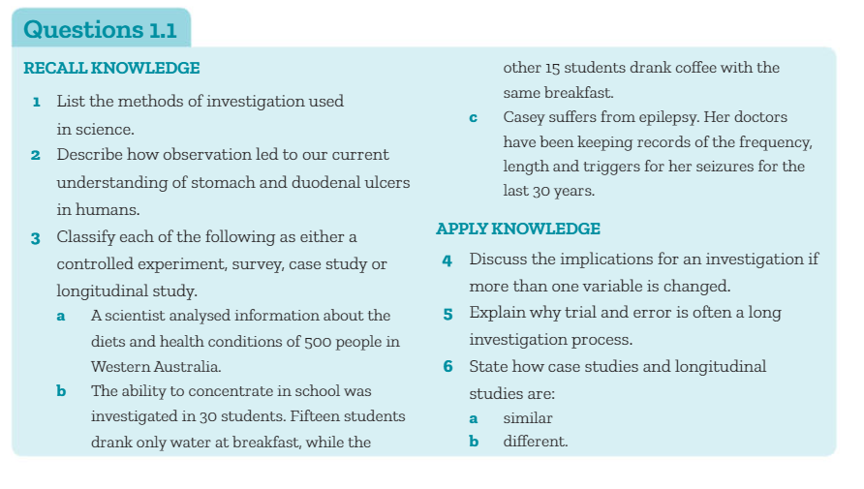

Slide 4
Steps in scientific method
Recognise problem
Collect info
Propose hypothesis
Test hypothesis
Analyse and interpret data
Draw conclusions

Slide 5
Purpose of a literature review
Help define problem
Find out current knowledge
Assess research methods
Relate findings to what is already known

Slide 6
Ethics
-voluntary participation
-informed consent
-no risk of harm
-confidentiality
Animal ethics: valid, humane, justifiable, considerate

